Slide 1


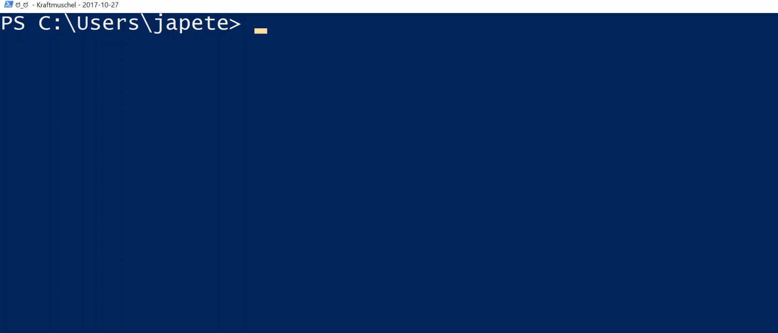
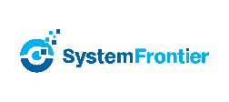




2017
Hybrid Lab Automation
Build an immutable application infrastructure with Nano Server, PowerShell DSC, and the
release pipeline
Ravikanth Chaganti

Slide 2
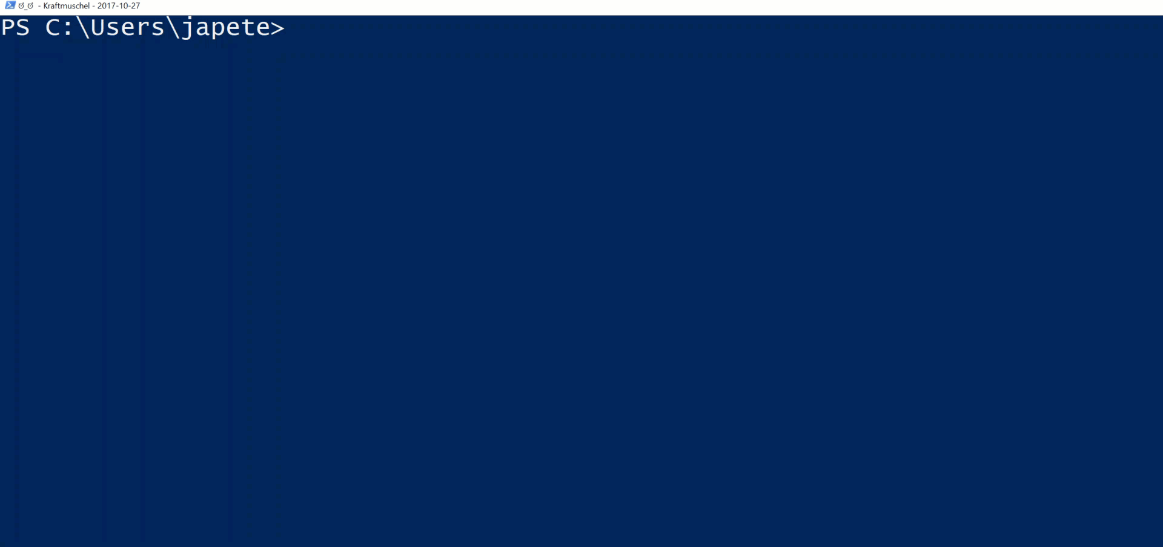
2017
Hands-On JEA
Build an immutable application infrastructure with Nano Server, PowerShell DSC, and the
release pipeline
We want to give you the chance to introduce and advertise yourself. Use the space inside this text box with a bio, picture, personal email, as you like.
This is strictly personal, do not abuse as free advertisement for your employer or other 3rd party.
While you can say that you are working for company ABC, you cannot say that ABC is a wonderful company providing the worlds‘ best services for XYZ. While you can show your email address, do not use a company generic email address like sales@xyz.com
Ravikanth Chaganti

Slide 3
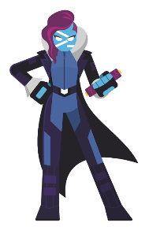
2018
2017
Build an immutable application infrastructure with Nano Server, PowerShell DSC, and the
release pipeline
Hybrid Lab Automation
Ravikanth Chaganti
Jan-Hendrik Peters, Raimund Andrée

Slide 4
Agenda
Introduction
Why automate?
Lab environment
Creating the lab
Creating and managing the connection

Slide 5
Why automate
Building labs is very time consuming
Lab configuration drifts over time
Knowledge of all required products may not be sufficient, e.g. PKI, SQL and Exchange
Consistency is needed on-premises and in the cloud

Slide 6
Why automate
Building labs is very time consuming
Lab configuration drifts over time
Knowledge of all required products may not be sufficient, e.g. PKI, SQL and Exchange
Consistency is needed on-premises and in the cloud
BECAUSE IT IS AWESOME!

Slide 7
Creating a lab
Module AutomatedLab (github.com/AutomatedLab)
Currently 143 cmdlets to create and manage labs
For Hyper-V, Azure and VMWare
Supports 34 different roles including
AD DS, AD CS, AD FS
SQL
…and loads more with easy customization capabilities

Slide 8
Using and accessing AutomatedLab
New-LabDefinition
Add-LabMachineDefinition
Install-Lab
Get-Command –Module AutomatedLab.Common

Slide 9
Demo
Hyper-V
2 DC, ADDS
File Server
Web Server
Gateway
Azure
2 DC, ADDS
File Server
Web Server

Slide 10
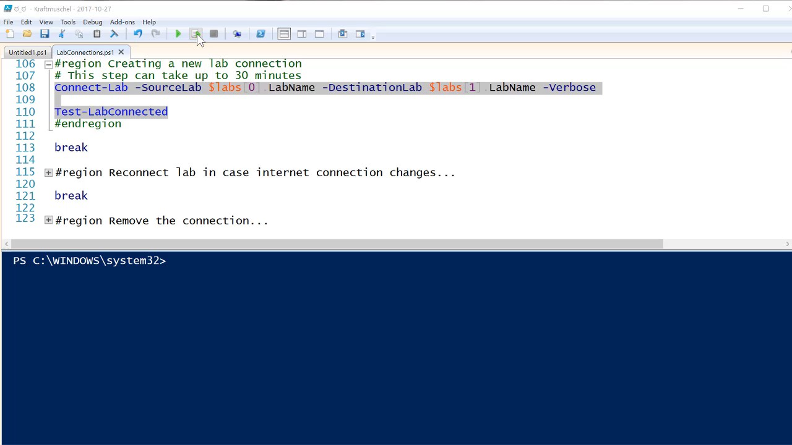
Demo – Connecting two labs

Slide 11
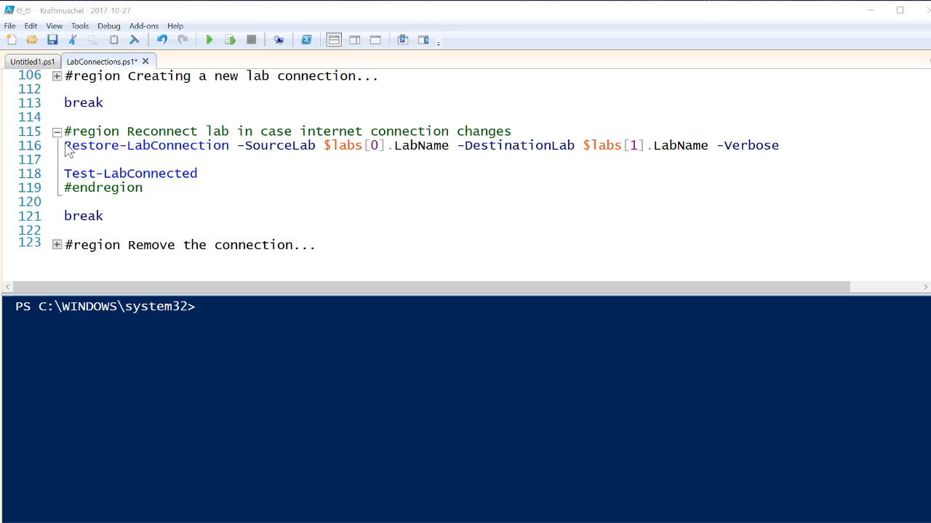
Demo – Reconnecting lab

Slide 12
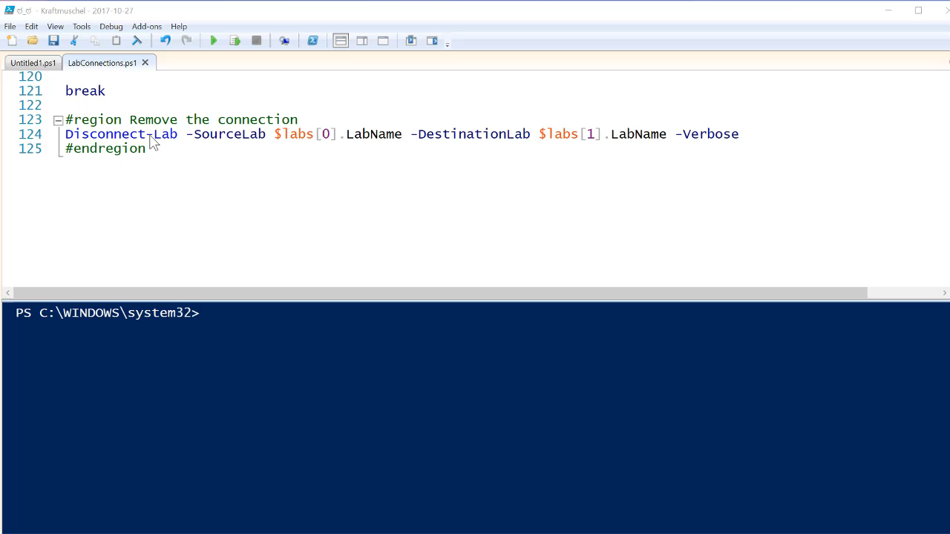
Demo – Disconnecting lab

Slide 13
Summary
Easily test hybrid scenarios
Generate consistent environments every time
Help is always welcome!
Get AutomatedLab and contribute: https://aka.ms/AutomatedLab/AutomatedLab
Star us! Fork us! Send some Pull Requests!

Slide 14
Next Steps
Now: 15 min break
Grab a coffee
Stay here to enjoy next presentation
Change track and switch to another room
Ask me questions or meet me in a breakout session room afterwards

Slide 15
Questions?

Slide 16
about_Author
PS C:\Users\japete> Get-Introduction
Name : Jan-Hendrik Peters
Born : 1987-01-24
Profession : Premier Field Engineer @ Microsoft Germany
Years in field : 8
Technologies : {PowerShell, DevOps, DSC, Active Directory}
Hobbies : {Travelling, Brewing, Coding, Hiking}

Slide 17
about_Author
PS C:\Users\raandree> Get-Introduction
Name : Raimund Andrée
Born : 1978-07-31
Profession : PFE @ Microsoft Germany
Years in Field : 23
Technologies : {PowerShell, DevOps, DSC, Active Directory}
Hobbies : {Travelling to high so called risk countries, Coding, Hiking}

